Slide 1
HAPPY TEACHERS DAY

Slide 2



Slide 3
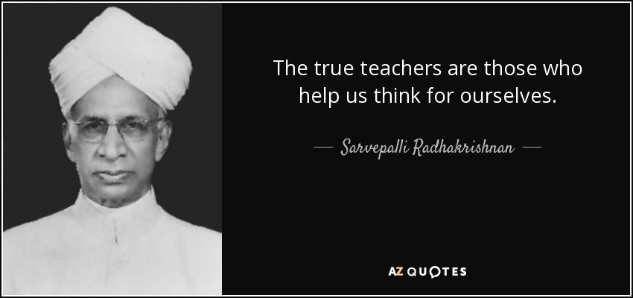

Slide 4
Thank You!!!

